Slide 1
Windows Phone 7 Development Considerations
By Simon Layton (LV002907) and Alex J Davison (DV003874)

Slide 2
Application Overview
Target audience: Fans of the London 2012 Olympics
Functionality objectives of application:
To allow fans to find out more about Team GB and its members.
To provide a facility for finding event information.
To allow the user to view the remaining time until the start of the Olympic games 2012.
To use media to enhance the users experience.
To ensure that the application provides a user friendly experience consistent with other Windows 7 phone applications
Application built using Microsoft Silverlight

Slide 3
Considerations for Application
Learnability – Use of a navigation pattern such as the List Menu (Theresa Neil, 2012)
Efficiency – Test application for speed and efficiency to reassurance to the user (Theresa Neil, 2012)
Memorability – The Beauty of an application makes the memorable application (Cao Dan, 2011)
Simplicity – “To keep the UI simple, the UI designer should employ actions, icons, words, and UI controls that are natural to the users.” (Deborah L. Stone, 2005)
Mapping – Mapping the application to the Operating System looking and feel (Brian Fling, 2009)
Notes:
Learnability – Using a navigation pattern allows the users to relate to the main interfaces used with GUI (Graphical User Interface) and allow for a better rating. Theresa Neil, 2012 states that many poor rating are due to Crashing, Lack of key features, porn navigation and/or confusing interface design.
Efficiency – Design for speed efficiency, and reassurance. Eliminate unnecessary fields and number the number of pages and steps.
Memorability – London 2012 a very memorable subject. Beauty of the interface interaction according to touch, hearing form and colour.
Simplicity – See quote.
Mapping – Mapping the application to the operating system keeps the application coincident with what the user is expecting.

Slide 4
Considerations for Application
Visibility - Understand the culture that the application is being designed for (Chen Yumiao 2010)
Feedback – Timely feedback to allow the user to know what the application is doing (Theresa Neil, 2012)
Consistency – Interactive behaviour and appearance of elements derived from same classes (Xiangqian Fu 2010)
Satisfaction – Making the user feel gratified after using the application
Notes:
Visibility – Construction of prototypes of the user interface to ensure that function is according to how the user expects, trial and error.
Feedback – Ensuring that the user knows what is happening, this ensures that the user does not think that the application has crashed and reassured
Consistency – Ensure that the application has the following, confirmed the target customer, acquisition target the habit of users integration, prompt and guide the user consistency of design goals and appearance elements.
Satisfaction – Give the user what they as quick as they want it.

Slide 5
limitations of Development
Phone Operating System (Microsoft 2012d)
No Internet Connection
800x480 screen resolution (Microsoft 2012b)
256MB RAM (Microsoft 2012b)
Common set of hardware buttons, including back button.
Multi-touch screen input
Limited battery life
Silverlight
C#
Status Bar, Application Space, Application Bar. Microsoft (2012a)
Hardware button(s)
Notes:
The limitation of the development are dictated by the two main components that of the device outlined and no internet connection.
Looking at the UI guidelines it clear to see that screen space was a limitations to ensure that all the information is viewable. Space is at a minimal with.

Slide 6
Use of media
Media Item | Use | Format
Home screen logo | Reinforce brand, visual reference for users to identify the home screen | .jpg – for small file size (Microsoft 2012c).
Biography images | Adds interest to page, shows users who they are reading about | .jpg – for small file size (Microsoft 2012c).
Countdown screen video | serves to build suspense towards the lead up to the start of the Olympic games. | .wmv – for small file size

Slide 7
Application Testing
Testing took place via a user questionnaire.
5 people took part.
They were given 10 – 15 mins with a device running the application and instructed to fill in the questionnaire.
They were asked to give any detailed observations in the comments boxes.
Questions centred around interface and use of media.
Results were converted into percentages and analysed with reference to the comments.
Questions with <80% agreement were reviewed and in many cases changes were made to the application to address these concerns.

Slide 8
Testing analysis – areas of concern
Several areas were highlighted by the questionnaire responses,
these were:
Biography screen:
Only 20% of users thought the text on the biography screen was large enough to read comfortably.
Comments suggested the text seemed uninteresting and users didn't want to read the whole text to get key information, such as the age of the athlete.
Event finder screen:
None of the users thought that the list items were easy to select and only 60% thought the text was large enough to read.
Only 20% of users realised they could leave lists with nothing selected to view all events.

Slide 9
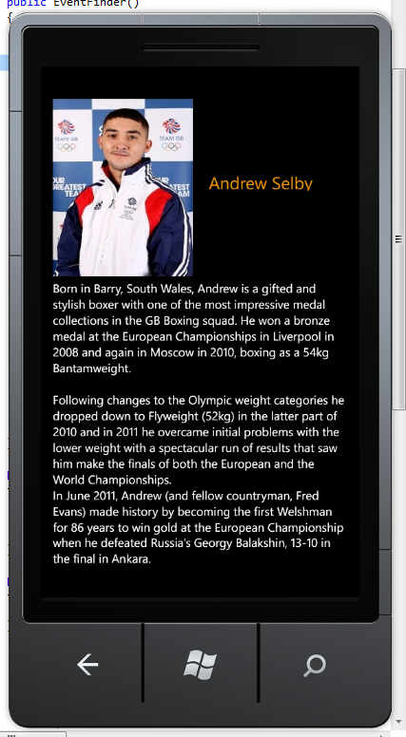
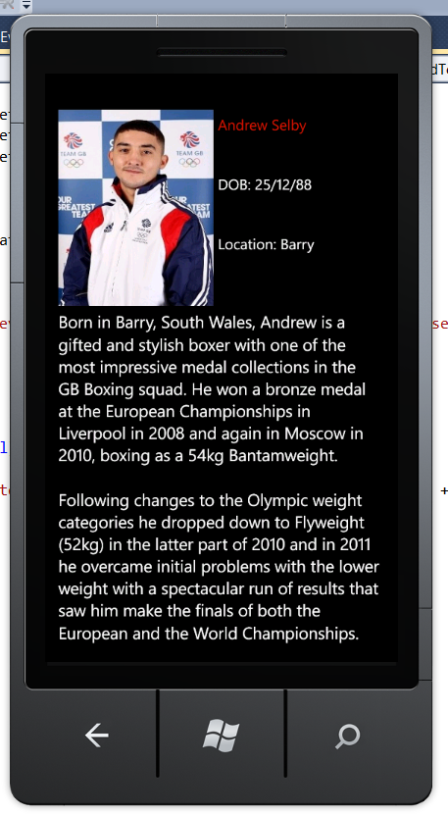
Testing response - Biography screen
Before
After
Key information from the text was extracted and put in easily accessible form at the top of the screen
Text was made larger and scrollable

Slide 10
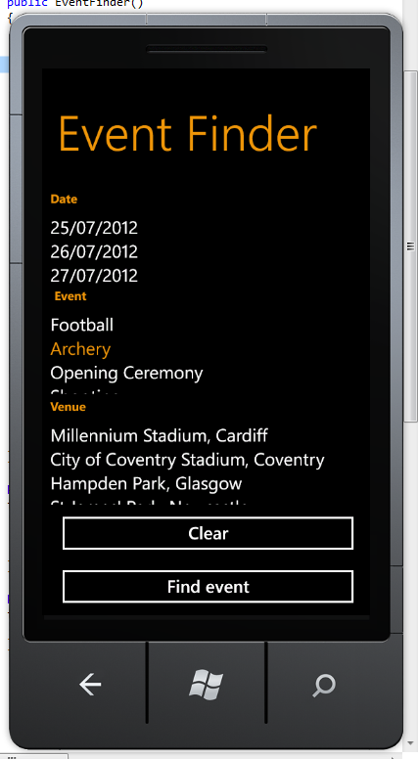
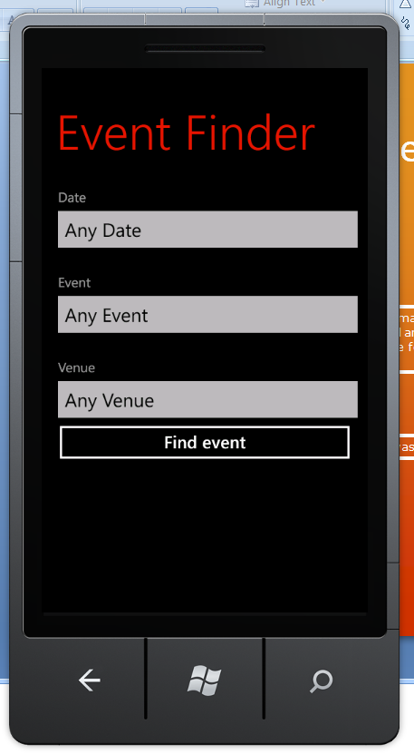
Testing response – Event finder screen
Before
After
The lists were replaced with drop down list picker controls. Lists with many options now open a full screen list when selected.
The clear button was removed and options to not filter on any of the categories were added to the lists. This makes it more clear to users how to view all events.

Slide 11
Thank you for listening and your time
Are there any questions?

Slide 12
Bibliography
Microsoft (2012e) Chapter 2 - Designing Applications for Windows Phone 7 [Online]. Available From: http://msdn.microsoft.com/en-us/library/gg490770.aspx [Accessed: 08/03/2012]
Theresa Neil (2012) Mobile Design Pattern Gallery: UI Patterns for Mobile Applications. O’Reily books, Inc. Sebastopol
Cao Dan (2011) Research on the function and formal beauty of product interface design. Product Innovation Management (ICPIM), 2011 6th p. 525 - 529
Brian Fling (2009) Mobile Design and Development. O’Reily books, Int. Sebastopol
Xiangqian Fu (2010) Mobile phone UI design principles in the design of human-machine interaction design. Computer-Aided Industrial Design & Conceptual Design (CAIDCD), 2010 IEEE 11th International Conference. p. 697 - 701

Slide 13
Bibliography
Microsoft (2012a) First Look at Windows Phone [Online]. Available From: http://msdn.microsoft.com/en-us/library/hh202905(v=vs.92).aspx [Accessed: 08/03/2012]
Chen Yumiao; Xu Jiang; Yang Zhongliang; (2010) Culture-adapted user interface design method for mobile phone: Correlation between user knowledge and icon. Computer-Aided Industrial Design & Conceptual Design. p. 177 - 180
Deborah L. Stone; Debbie Stone (2005) User interface design and evaluation. p.170
Microsoft (2012d) ListBox Control Design Guidelines for Windows Phone [Online]. Available From: http://msdn.microsoft.com/en-us/library/hh202882(v=vs.92).aspx [Accessed: 08/03/2012]

Slide 14
Bibliography
Microsoft (2012b) Hardware Specifications for Windows Phone [Online]. Available From: http://msdn.microsoft.com/en-us/library/ff637514(v=VS.92).aspx [Accessed: 08/03/2012]
Microsoft (2012c) Performance Considerations in Applications for Windows Phone [Online]. Available From: http://msdn.microsoft.com/en-us/library/ff967560(v=vs.92).aspx#BKMK_Images [Accessed: 08/03/2012]

